Slide 1


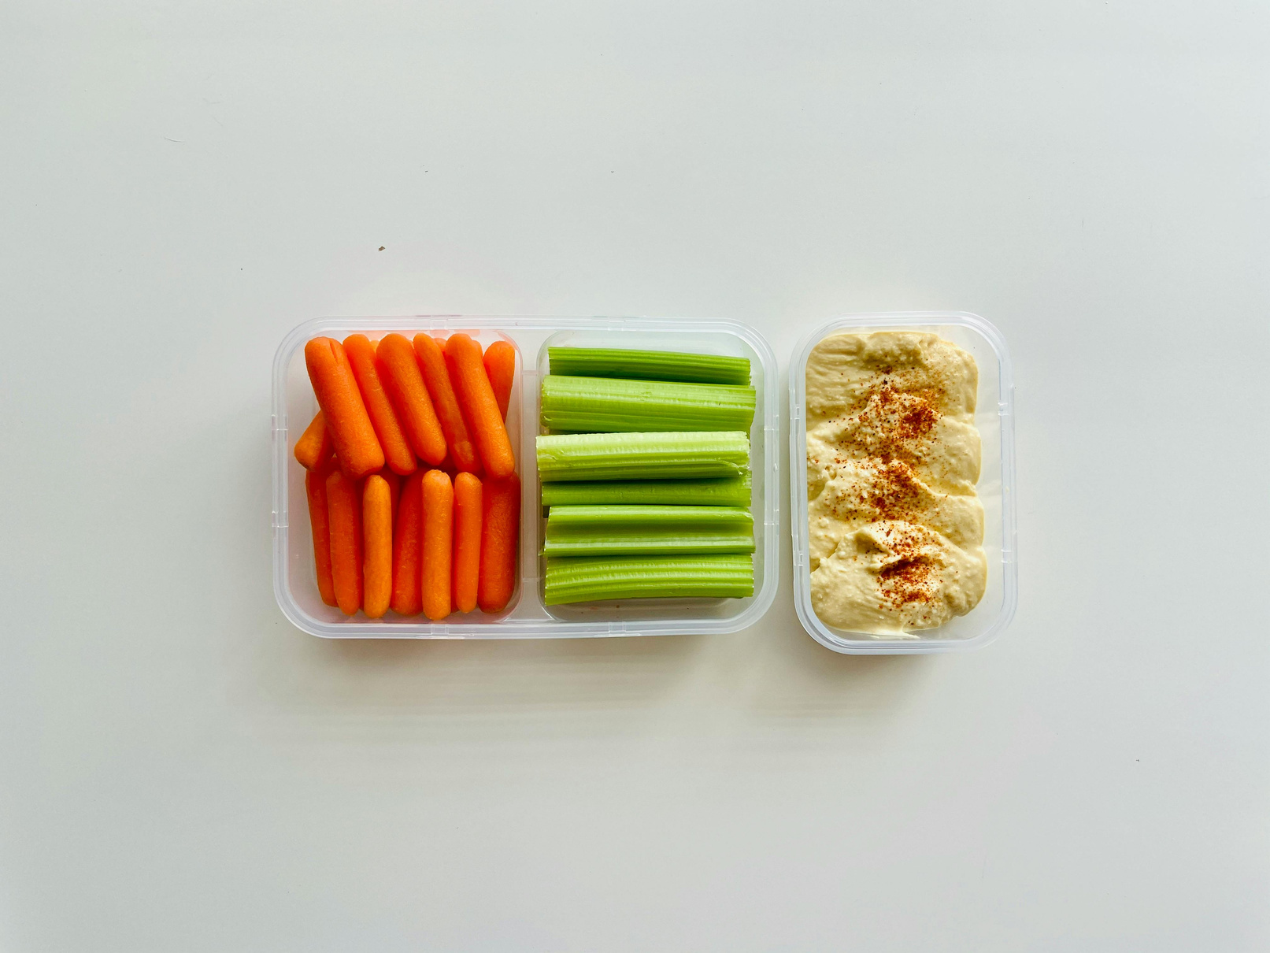
DailyUtility
Daily Utility — One App. Every Day-of-Life Tool.
Tasks, notes, finance, calculators, prayer, vault, quiz — 20+ daily tools, fully offline, fully bilingual (বাংলা / English), in a single Material 3 Flutter app.
Proposal
Q3 2026
20+
Offline-First
Built-in Tools
Storage Model

Slide 2

DailyUtility
The App-Overload Problem
Nobody wants to install twelve apps to live one week
Most people juggle 8–12 separate apps just to get through a normal week — a to-do app, a notes app, a finance tracker, a separate calculator, a habit app, a prayer app, a vault. Each one demands its own account, its own subscription, its own sync.
8–12 apps
$ 200 / yr
Average number of utility apps installed on a single phone.
Combined annual subscriptions across productivity, finance and lifestyle tools.
0% privacy
Heavy on data
Default cloud apps sync your tasks, notes and passwords to servers you don't control.
Many separate apps mean battery drain, storage use and constant notification noise.

Slide 3
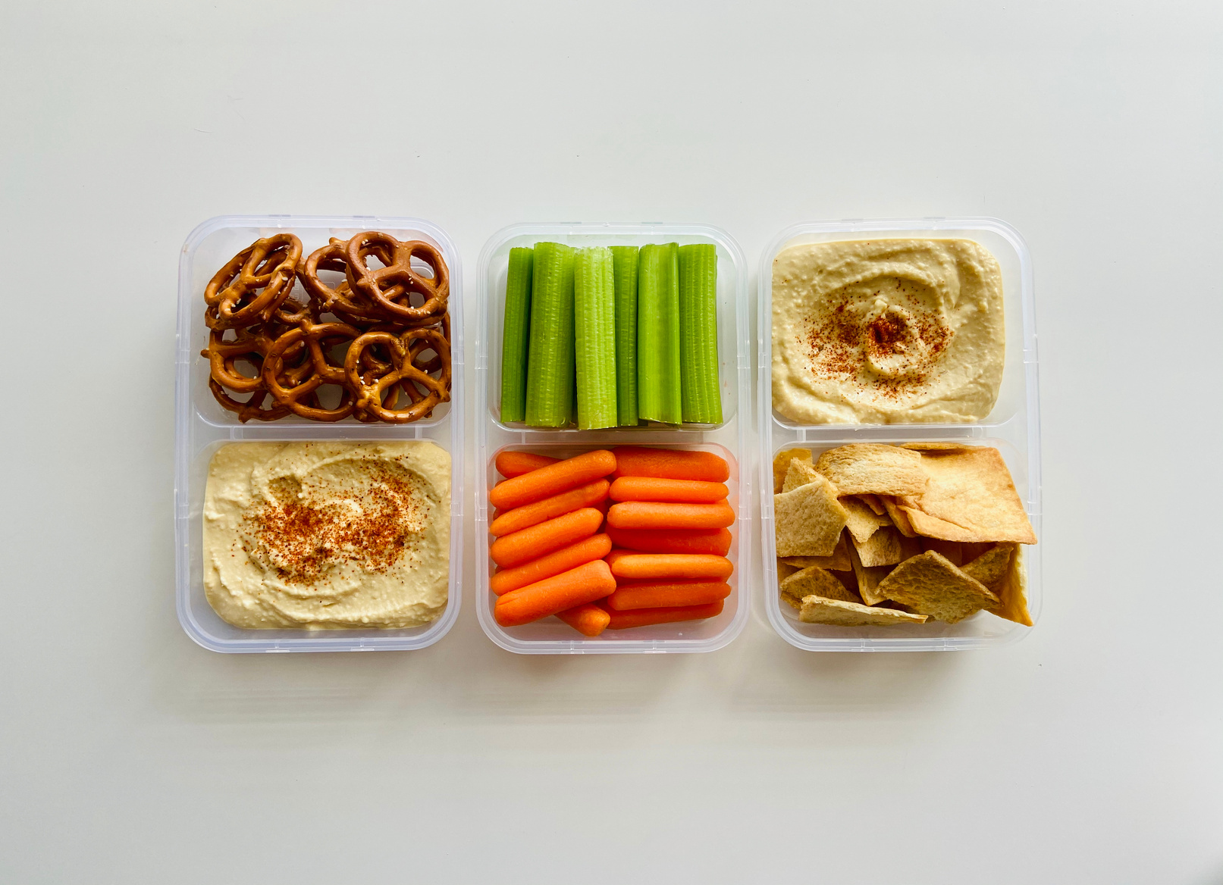
DailyUtility
Our Solution
20+ Tools in One Codebase
A single offline-first Flutter app covering the whole day — productivity, money, lifestyle, utilities, security.
Bilingual & Themed
Bilingual UI (English / বাংলা), light + dark Material 3 themes, responsive from small phones to tablets.
Offline-First by Design
Personal data is stored locally with Hive, so it never leaves your phone. Only public content (notice board, quiz, contact) touches Firebase.
One Design System
Every screen uses the single Theme.of(context).colorScheme tokens — no hardcoded colours, no design drift.
Your Day, One App
Tasks, notes, finance, loans, subscriptions, vault, habits, mood, prayer, quiz, posts, backup — all in one Material 3 app.
100%
Personal data stored on your device — nothing leaves without you tapping "Share".

Slide 4
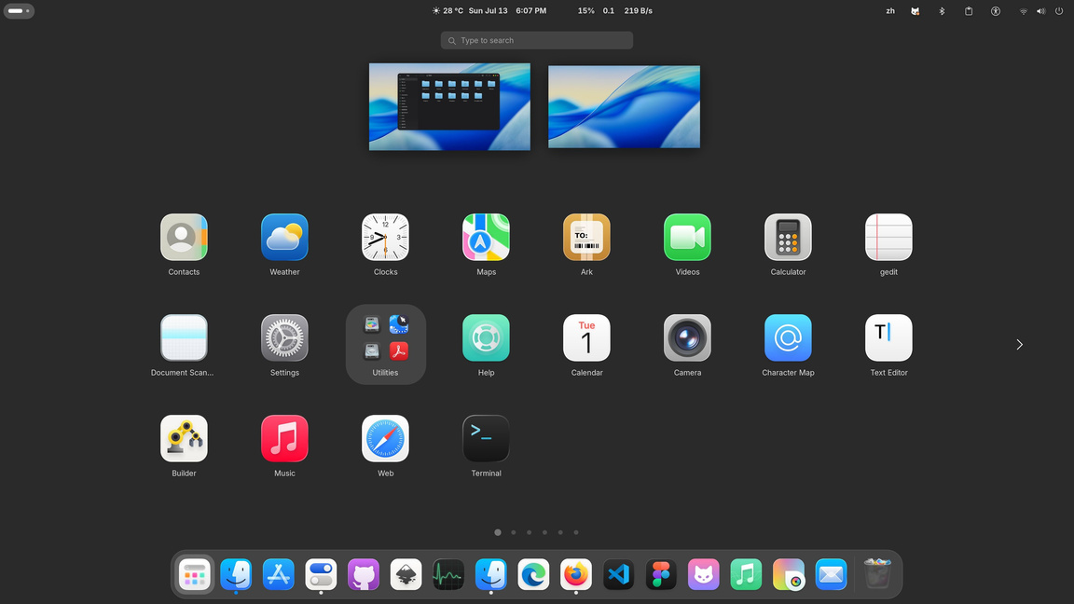

DailyUtility
How the App Works
Service-per-Feature
Hive + Firestore Hybrid
Each feature has one screen and one service singleton with a ValueNotifier — fast, predictable and trivial to extend.
Personal data in typed Hive boxes, public data fetched from Firestore — three collections: notice, quiz_categories, contact_messages.
Local Reminders
Offline Prayer & Qibla
flutter_local_notifications fires reminders for tasks and loan instalments — one sorted "Reminders" view shows them all.
Prayer times computed fully offline by adhan_dart from cached lat/long; optional geolocator for GPS detect and live Qibla.

Slide 5


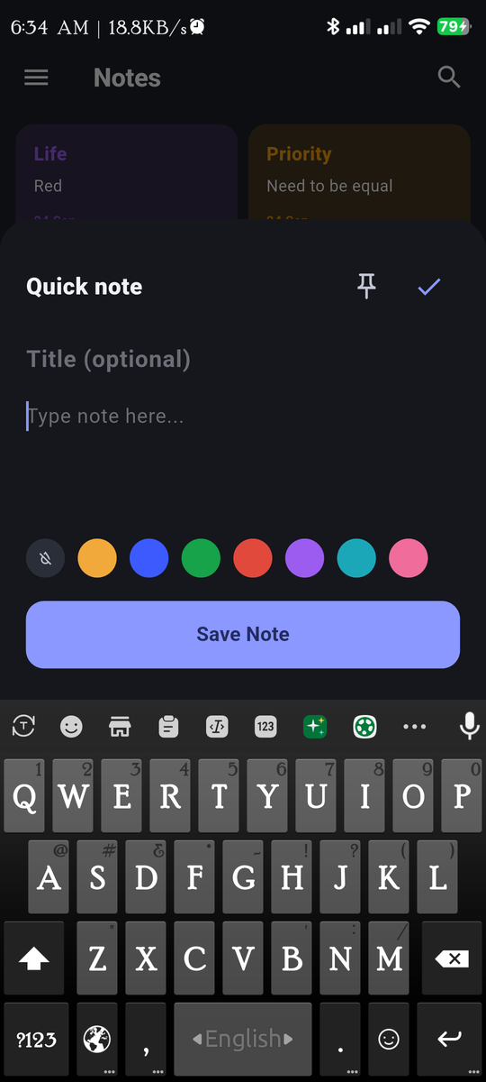
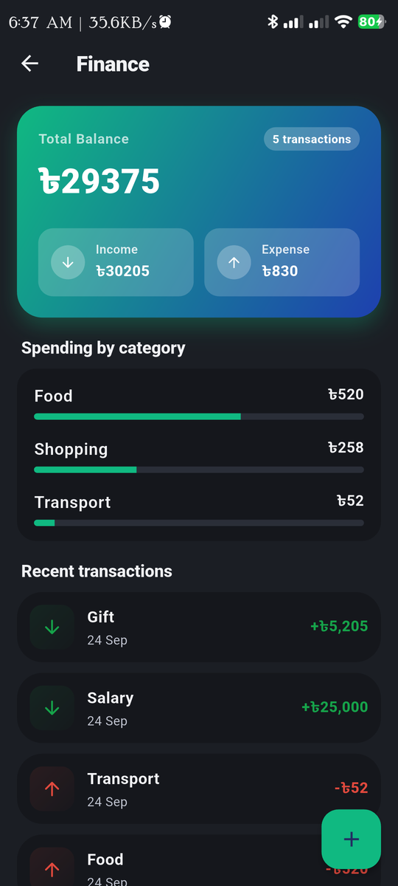

DailyUtility
Key Features: Everything You'd Otherwise Install 12 Apps For
Tasks & Notes
Finance Suite
Tasks with priority, due date, recurrence and reminder. Active list with progress badge, completed-history tab.
Income / expense, Baki Khata people-ledger, loan tracker with progress bar, and a Netflix/Spotify-grade subscription manager.
Calculators & Converters
Lifestyle & Habits
20+ calculators across General, Education, Health, Finance and BD Special — plus Unit Converter and Date Tools.
Habit tracker with streak + consistency, Daily Reflect, shopping list, and reminders aggregated across tasks and loans.

Slide 6
DailyUtility
Who It's For
English-Speaking Markets
50,000+
Productivity-app users who want one offline-first tool replacing 8–12 separate apps — privacy-conscious, subscription-fatigued, mobile-first.
500+
Students using a Baki Khata, tracking subscriptions and acing GPA / CGPA — Bangladesh first, English-speaking markets next.
Friends, family & colleagues in Bangladesh testing the local tools (Baki Khata, BD land-units, prayer).
Early Access Cohort

Slide 7



DailyUtility
How It Stays Free & Sustainable
Today the app is fully free, fully offline, no ads, no accounts. When sustainable monetisation lands, it lands gently:
Pro Tier (Future)
Brand Partnerships
Optional Pro tier (planned): cloud-restore, multi-device sync, advanced analytics in Habits/Mood, premium calculators.
Sponsorships for the curated BD-special calculators and co-branded notice-board placements on the public content layer.

Slide 8
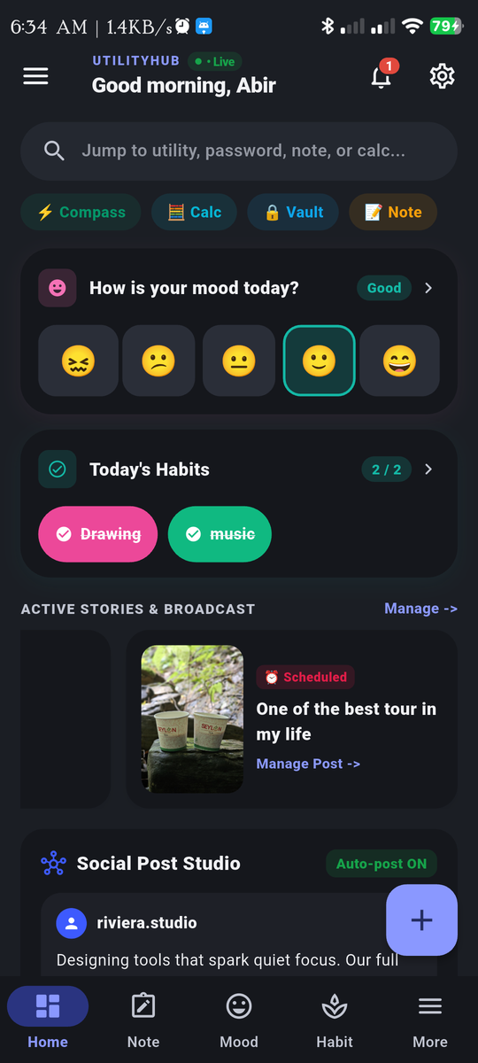
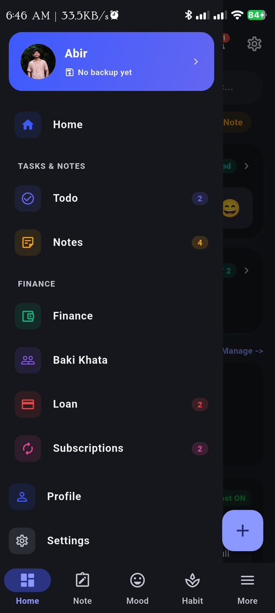
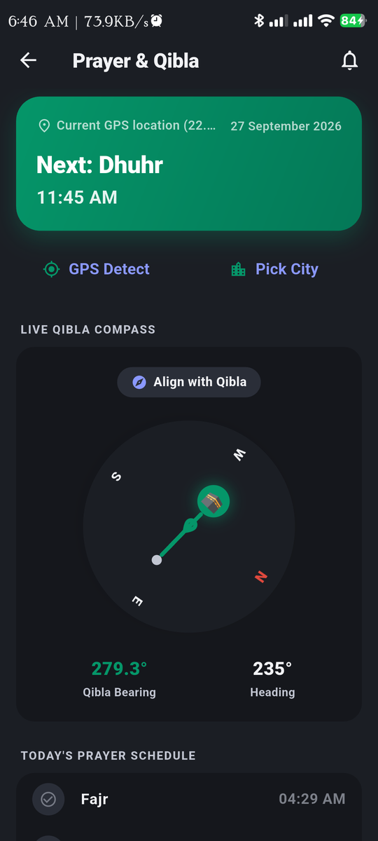
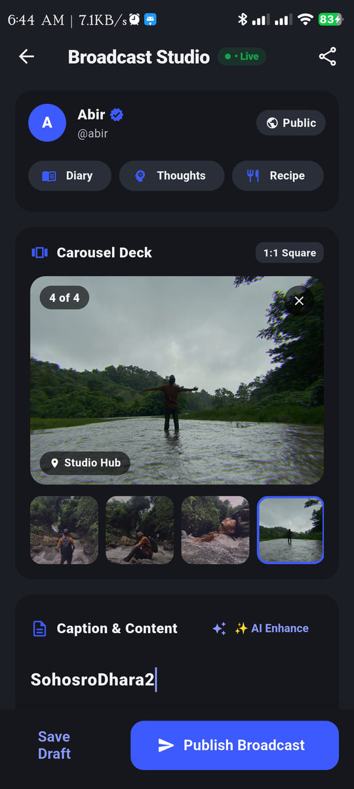
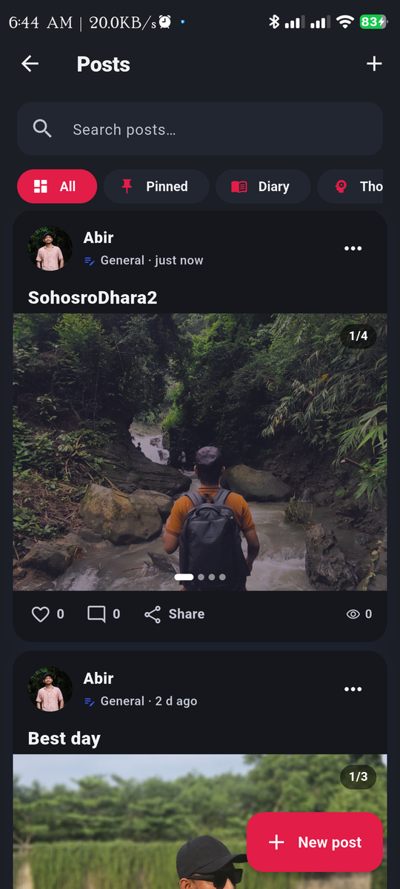
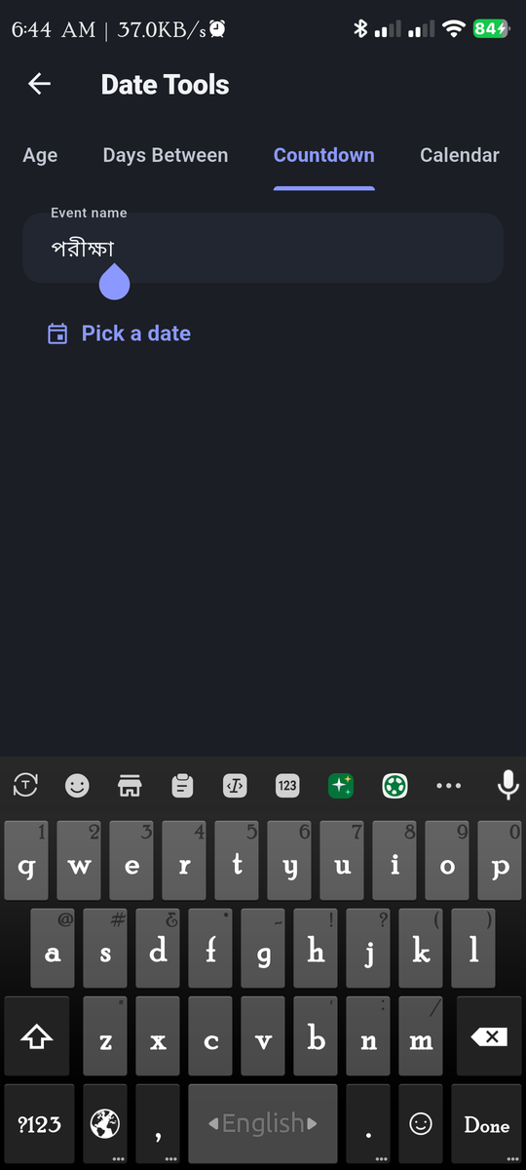

DailyUtility
Traction & Status
Every personal feature — tasks, notes, finance, baki, loans, subscriptions, habits, mood, vault, shopping, calculator history — works with the airplane mode on.
Personal Data Coverage
User Rating (internal)
20+
100% Offline

Slide 9



DailyUtility
Built Solo,
End-to-End
Daily Utility is currently a one-person project: design, Flutter code, Hive/Firebase wiring, screenshots, README and pitch deck are all maintained solo. Early users from Bangladesh are testing the local features (Baki Khata, BD land-units, prayer times).
Nazmul
Community
Open Source
Designer · Developer · Maintainer
Bengali-first testers
MIT-licensed Flutter codebase
nazmulislamabir1500@gmail.com
500+ invite list
PRs welcome

Slide 10





DailyUtility
One Phone. Twenty Tools.
Zero Servers Touching Your Data.
Try the build, send feedback, or open an issue on GitHub — every report shapes the next release.
Nazmul
hello@reallygreatsite.com
123 Anywhere St., Any City, ST 12345

